Slide 1
Habitability of Serpentinization-hosted ecosystems
Taylor Walton, Alta Howells, Dr. Everett Shock
Arizona Space Grant Symposium April 13th, 2019
Notes:
Presentation cannot last more than 7 minutes: symposium rules.

Slide 2
Aim
Using a culture-dependent approach, we aim to determine the biotic and abiotic effect on pH using microbial growth media designed for a hyperalkaline system
This is done in order to determine an effective buffering system for hyperalkaline growth media by isolating a microbe actively growing pH >11.0.
Notes:
Hyperalkaline=serp lead into details

Slide 3
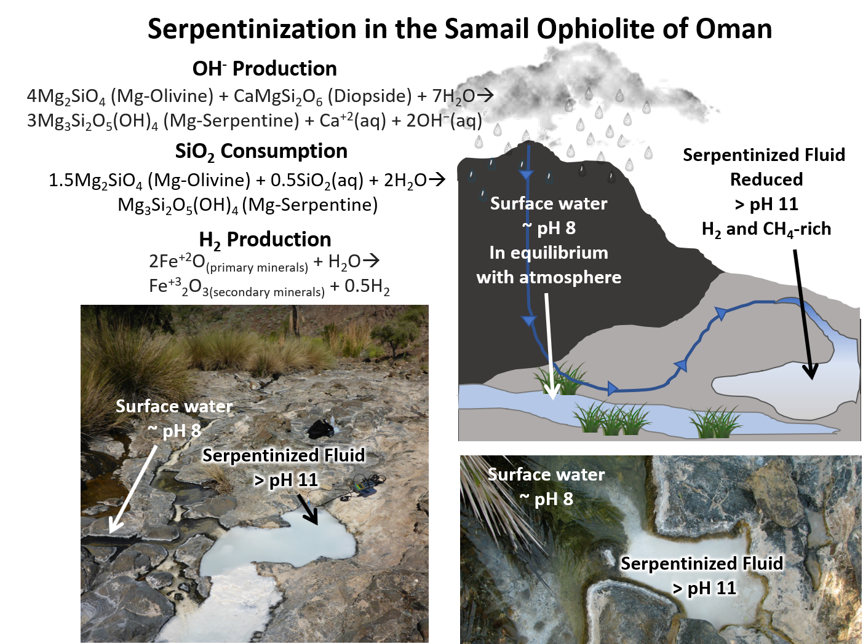
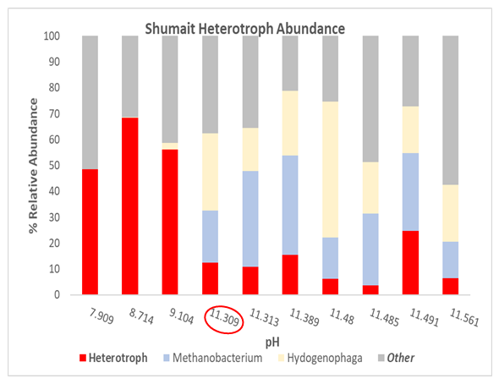
Environmental observations
Notes:
Serp→ hydrogen ox, methanotrophy, methanogensis→ biomass for heterotrophy→shumait diagram

Slide 4
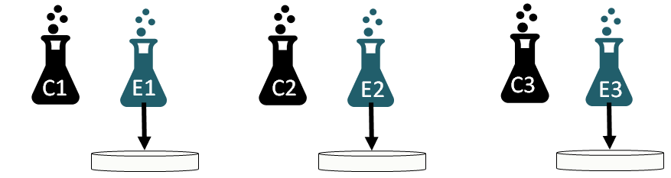
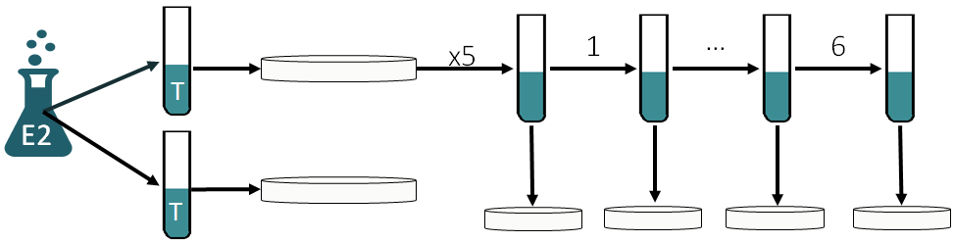
Methods
Phase 1: Determining biotic and abiotic influence on pH over time
Measuring Optical density and pH over time, performed in triplicate
C= Control
E= Enrichment
Phase 2: Maintain growth and attempt to isolate a microbe for further study

Slide 5
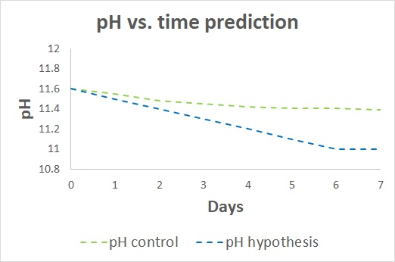
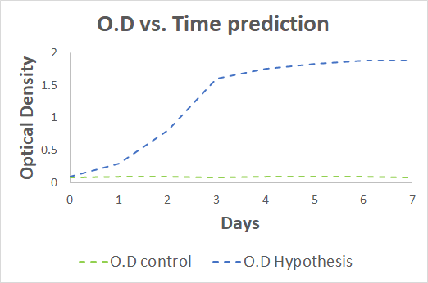
Methods

Slide 6
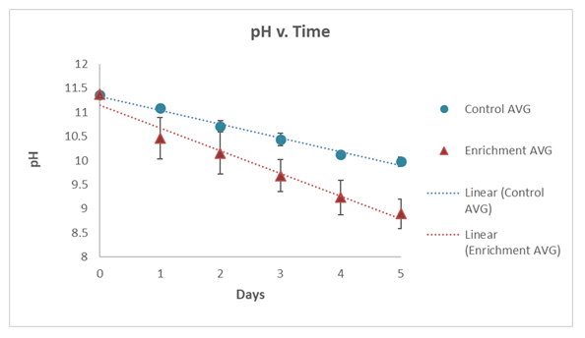
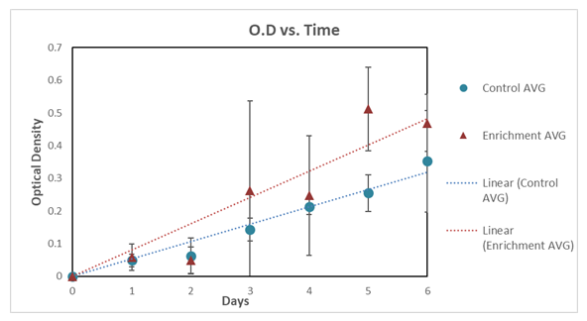
Results phase 1
pH was not kept >11.0 in either condition
pH of inoculate decreased 1.6x faster than the control
O.D increased in both conditions
O.D of inoculate increase 1.5x faster than the control
Notes:
Possible mineral: co2→caco3→ lower pH, increased O.D

Slide 7
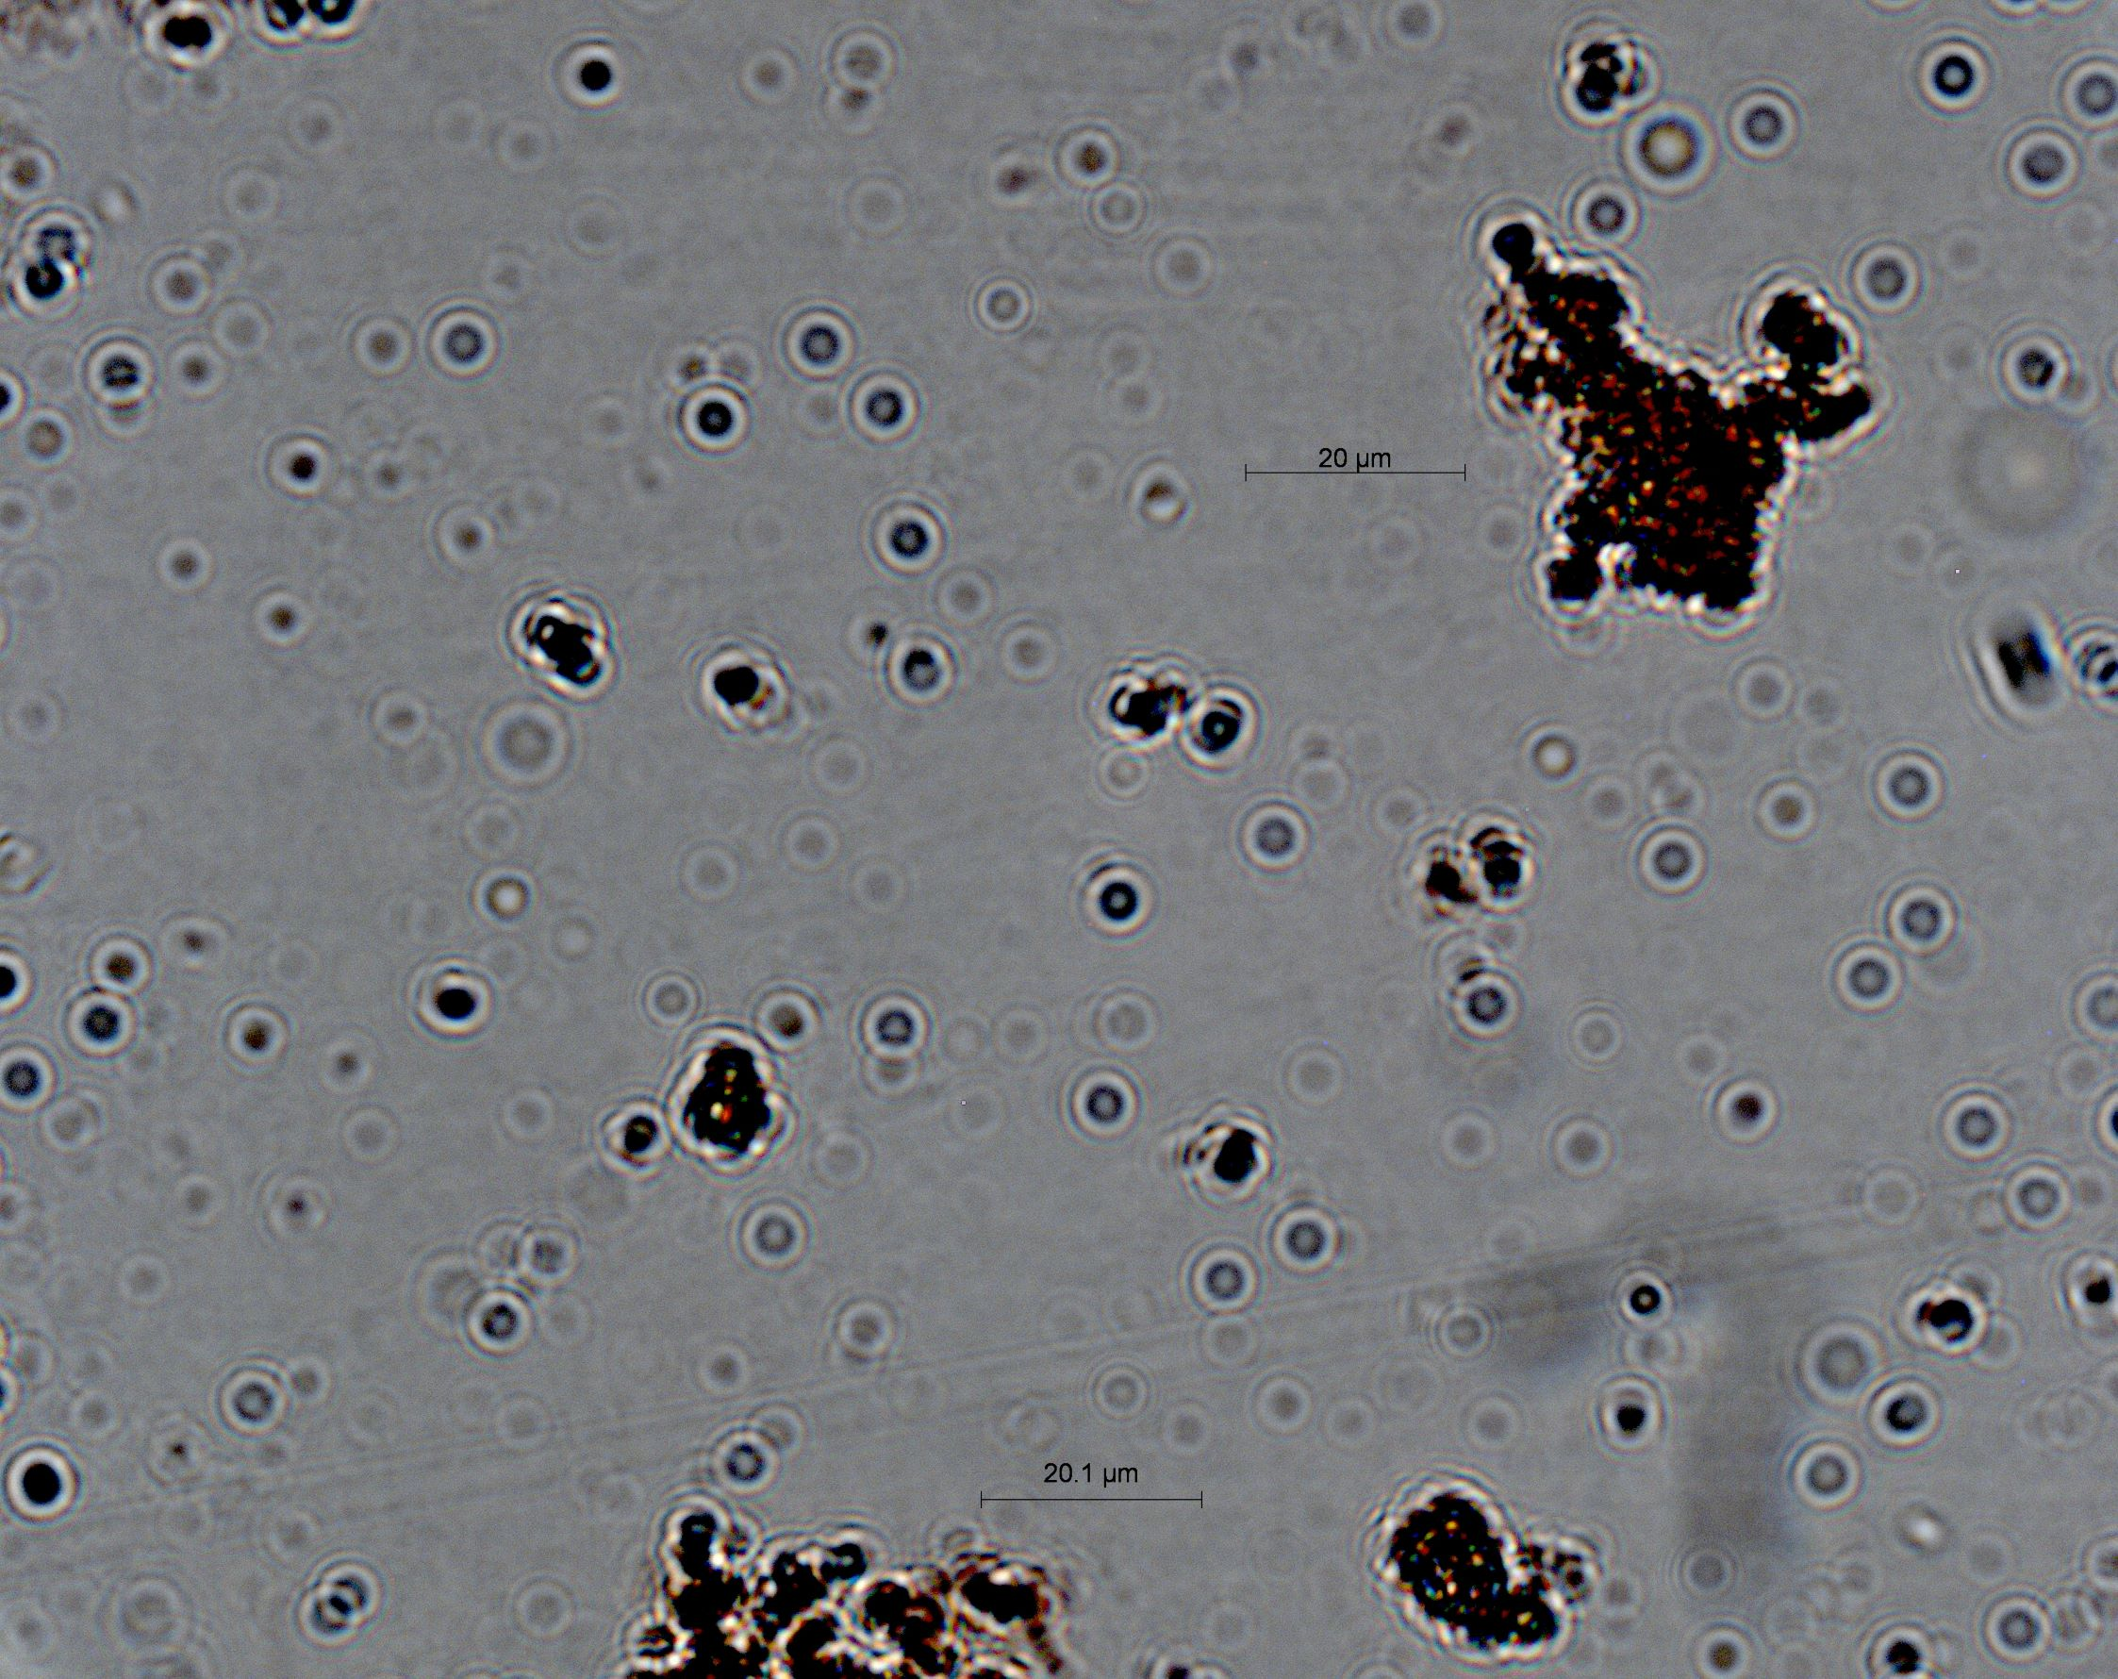
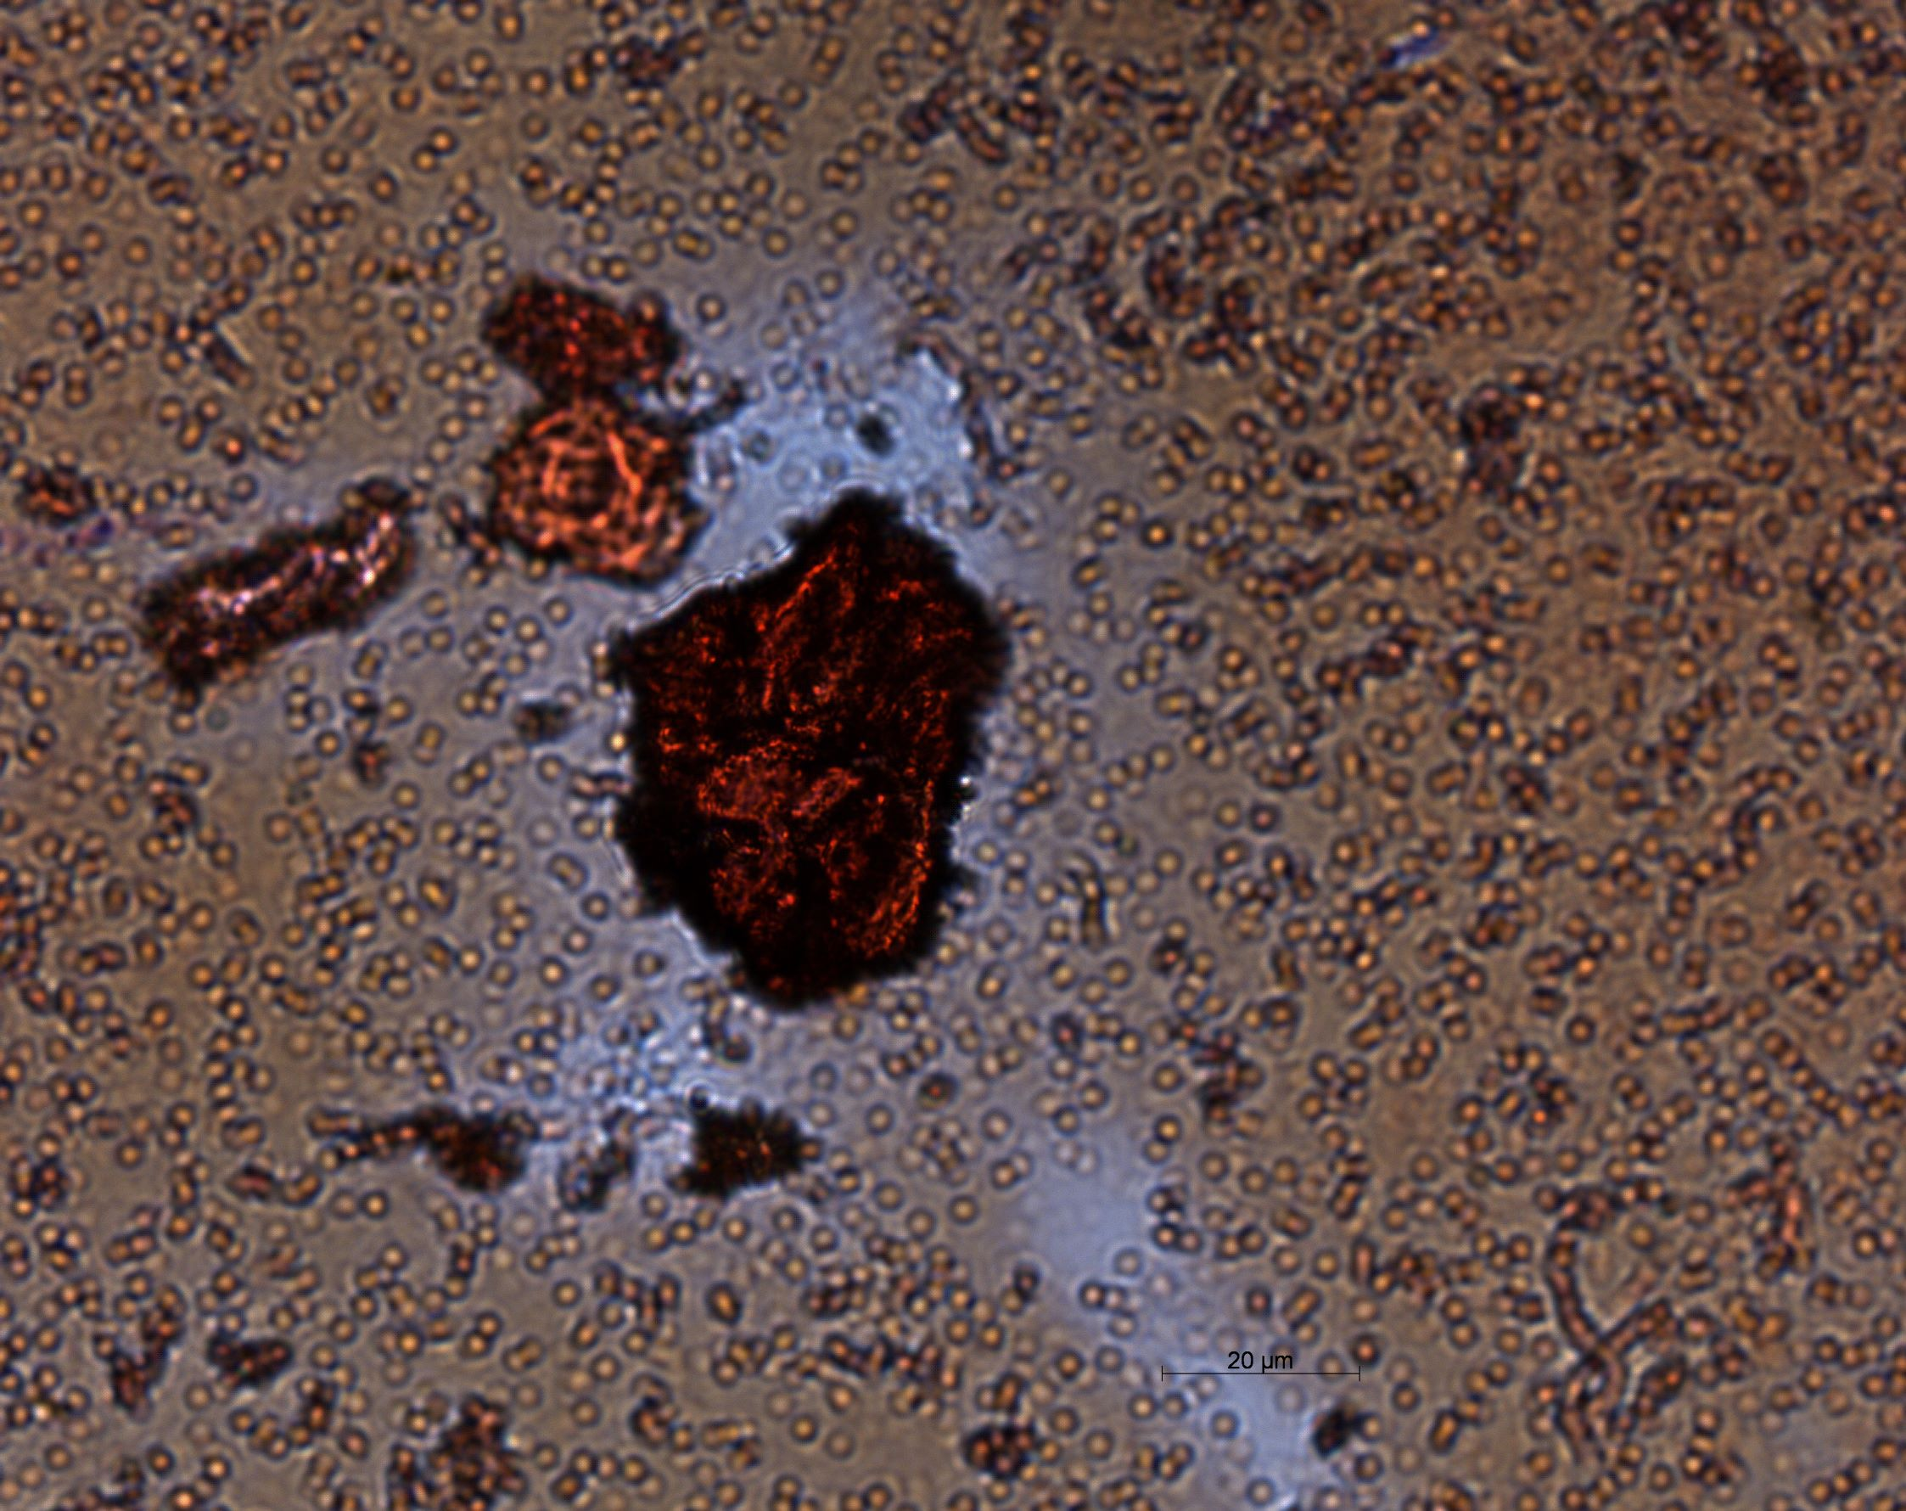
Results phase 2
20 um
Colony 4: 8 days growth
Gram staining indicates that microbial growth was successful
Colony 2 has a significant presence of gram – cells
Colony 4 is a possible mixed community.
Neither colony indicates if single isolates were captured
Colony 2: 7 days growth
20um
Notes:
Colony 4: unclear, potential mixed community, colony 2: definitely gram negative, large red thing is not a cell, potentially a cell cluster or mineral from the plate

Slide 8
Early conclusions and future work
Phase 1 indicated that current microbial growth media not optimized to maintain pH >11.0 in both abiotic and biotic conditions
          thermodynamic modeling could determine possible mineral precipitation
Phase 2 indicated successful microbial growth visualized with the gram stain
          DNA analyses could determine the identity of the plate communities.
  Future work includes optimizing growth conditions using modeling data, DNA analyses to determine identity of community, and isolation to determine effective buffering system

Slide 9




Acknowledgements
ASU/NASA Space Grant Program
GEOPIG Research group, Dr. Shock and Alta Howells
Rock Powered Life

